Slide 1

Direct Acting Antiviral Drugs (DAADs)
By
Sara Mohammad Mahrous
Assistant Lecturer Of Tropical Medicine And Gastroenterology

Slide 2
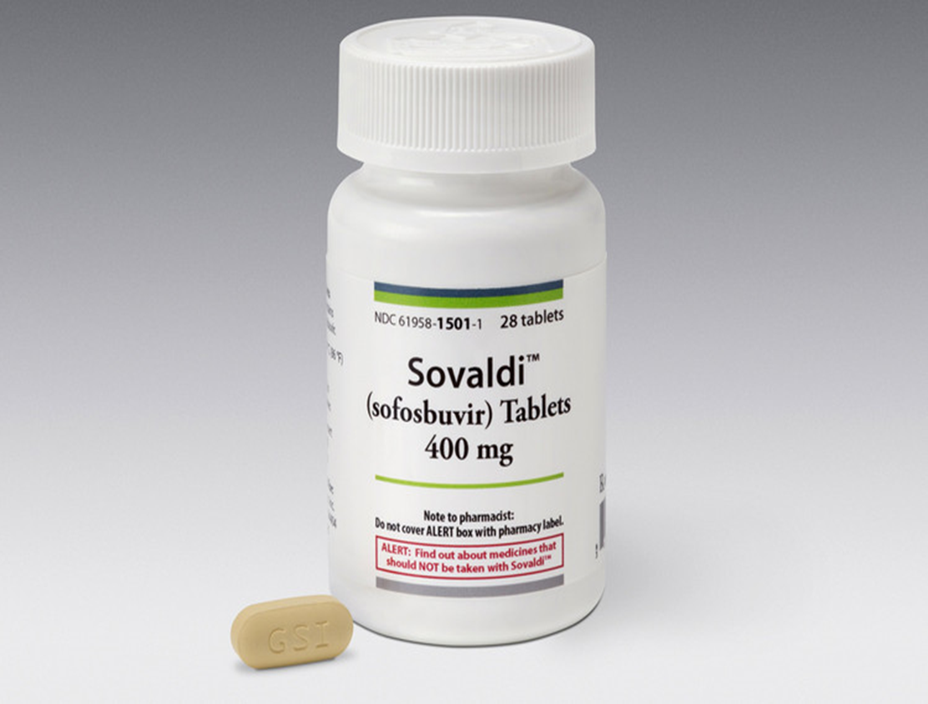
Sofosbuvir
Mechanism of action: inhibitor of HCV NS5B RNA-dependent polymerase; its inhibition in turn suppresses viral replication

Slide 3
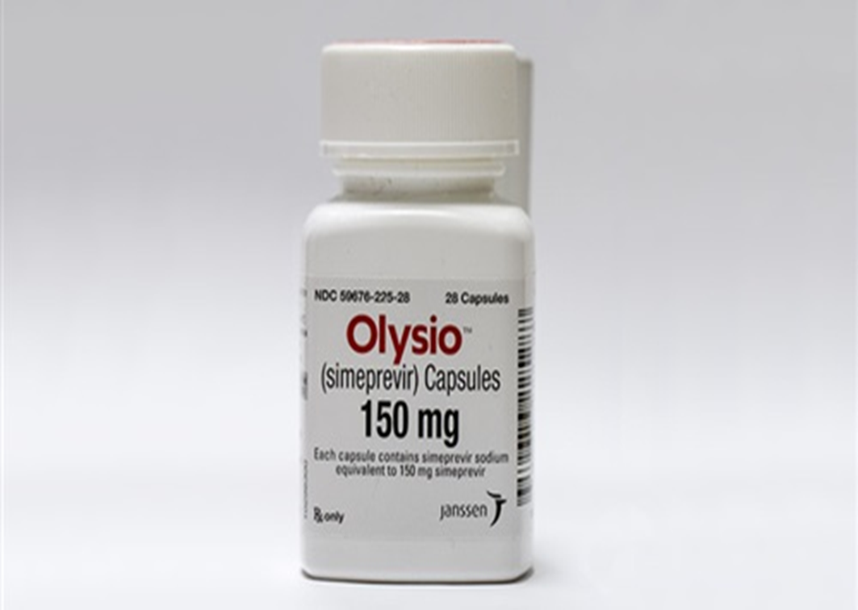
Simeprevir
Mechanism of action: inhibits HCV NS3/4A protease
Side effects: Rash; including photosensitivity, hyperbilirubinemia, Pruritus, Nausea, Myalgia, Dyspnea

Slide 4
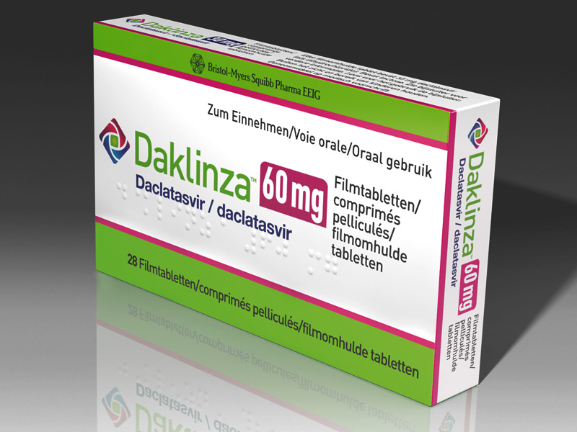
Daclatasvir
Mechanism of action: Inhibits NS5A, a nonstructural protein encoded by HCV

Slide 5
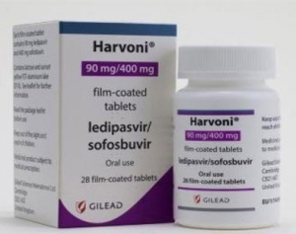
ledipasvir/sofosbuvir
Mechanism of action:
Ledipasvir: Inhibits HCV NS5A protein
Sofosbuvir: inhibitor of HCV NS5B RNA dependent polymerase; its inhibition in turn suppresses viral replication

Slide 6
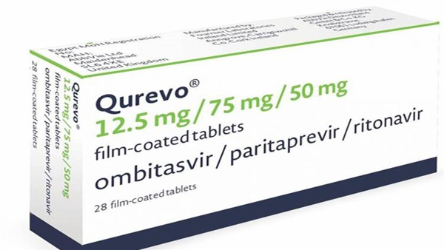
Ombitasvir/paritaprevir/ritonavir
Mechanism:
  Ombitasvir- NS5A inhibitor
  Paritaprevir- NS3/4A protease inhibitor
  Ritonavir- CYP3A4 inhibitor

Slide 7
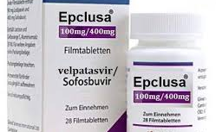
Velpatasvir/ sofosbuvir
Mechanism of action:
Velpatasvir: Inhibits HCV NS5A protein
Sofosbuvir: inhibitor of HCV NS5B RNA dependent polymerase

Slide 8
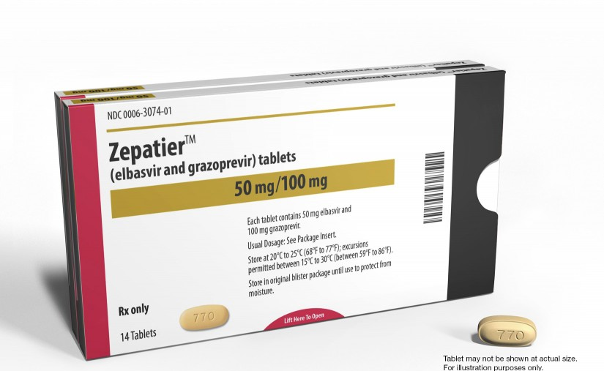
Elbasvir / grazoprevir
Mechanism of action:
Elbasvir is an inhibitor of HCV NS5A.
Grazoprevir is an inhibitor of HCV NS3/4A protease,

